Slide 1
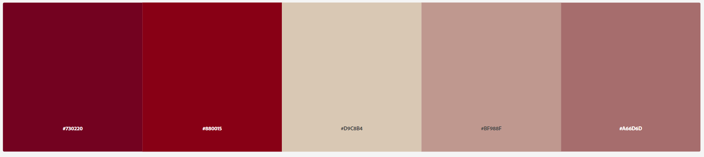

AAA708 Microprocessor-based Systems Design
Assignment #3
컴퓨터학과 석사과정 유 종 상
2023. 01. 18.

Slide 2

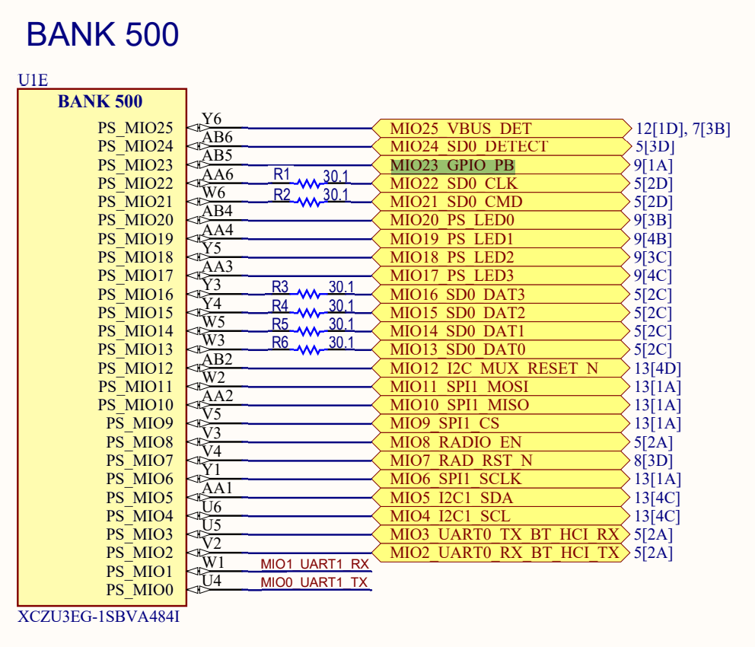
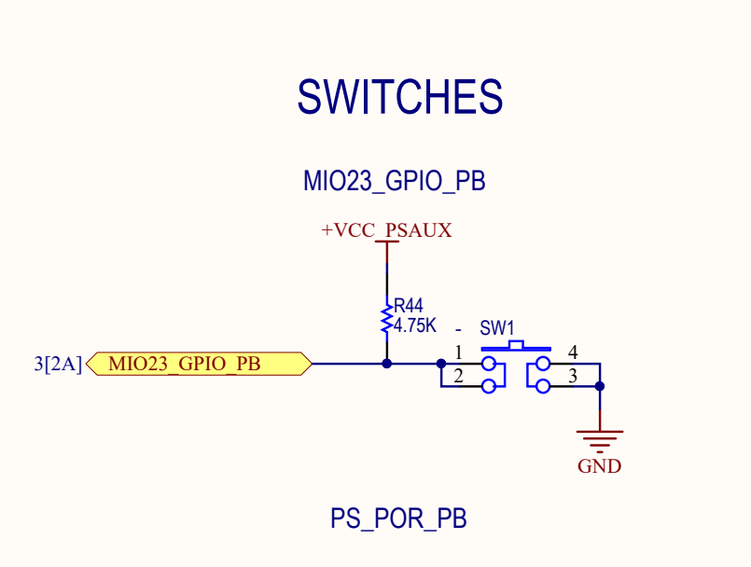
Schim

Slide 3

R3(related with PB) status
LED | OFF |  |  | ON
 | HEX | HEX_Important | BIN_Important | HEX | HEX_Important | BIN_Important
0000 | 0x0080 0000 | 0x0080 | 0b1000 0000 | 0x0000 0000 | 0x0000 | 0b0000 0000
1000 | 0x0090 0000 | 0x0090 | 0b1001 0000 | 0x0010 0000 | 0x0010 | 0b0001 0000
0100 | 0x0088 0000 | 0x0088 | 0b1000 1000 | 0x0008 0000 | 0x0008 | 0b0000 1000
0010 | 0x0084 0000 | 0x0084 | 0b1000 0100 | 0x0004 0000 | 0x0004 | 0b0000 0100
0001 | 0x0082 0000 | 0x0082 | 0b1000 0010 | 0x0002 0000 | 0x0002 | 0b0000 0010

